Slide 1
Chapter 2 Atomic Structure
Wilt Gu

Slide 2
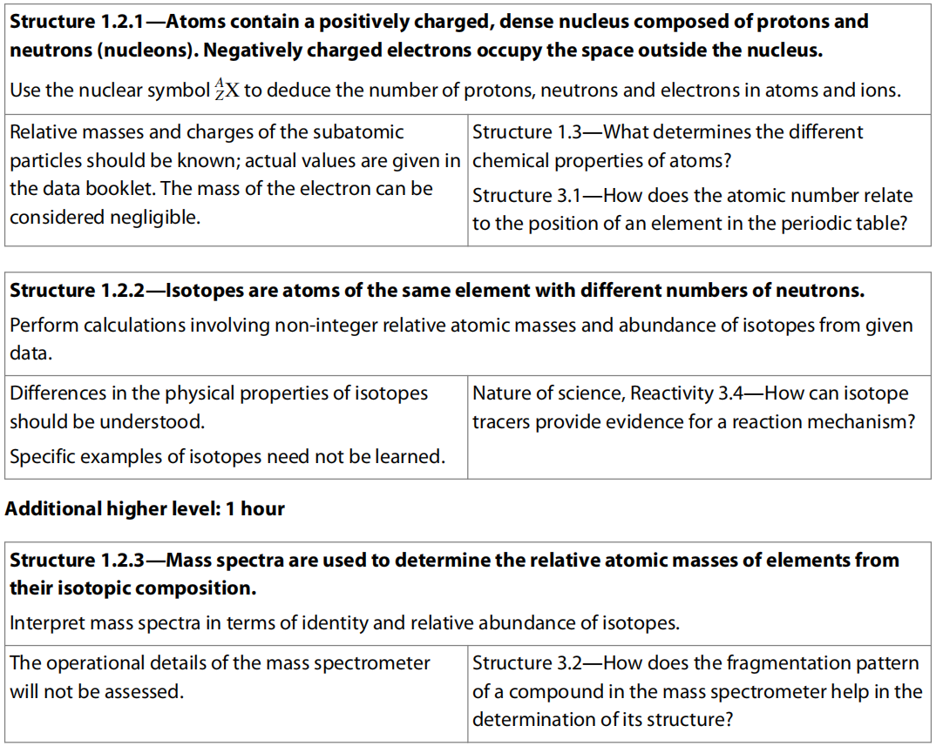
2.1 The Nuclear Atom

Slide 3
History of Discovery of Atomic Structure
Democritus: Idea of particles called “atom”
John Dalton: Atomic theory
J.J. Thomson: Cathode ray tube and discovery of electrons
Ernest Rutherford: Gold foil experiment and the idea of nucleus in the center of an atom
Niels Bohr: Atomic model with energy levels (Shells)

Slide 4
Dalton’s atomic theory
One of the first great achievements of chemistry was to show that all matter is built from about 100 elements.
The elements are substances which cannot be broken down into simpler components by chemical reactions, so they are the simplest substances and their names are listed in your IB data booklet (section 5).
Different elements have different chemical properties but gold foil, for example, reacts in essentially the same way as a single piece of gold dust.
Indeed if the gold dust is cut into smaller and smaller pieces, the chemical properties would remain essentially the same until we reached an atom.
This is the smallest unit of an element.
There are only 92 elements which occur naturally on earth and they are made up from only 92 different types of atom.

Slide 5
The modern idea of the atom dates from the beginning of the 19th century.
John Dalton noticed that the elements hydrogen and oxygen always combined together in fixed proportions. To explain this observation he proposed that:
all matter is composed of tiny indivisible particles called atoms;
atoms cannot be created or destroyed;
atoms of the same element are alike in every way;
atoms of different elements are different;
atoms can combine together in small numbers to form molecules.
Using this model we can understand how elements react together to make new substances called compounds.
The compound water, for example, is formed when two hydrogen atoms combine with one oxygen atom to produce one water molecule.

Slide 6
Dalton was the first person to assign chemical symbols to the different elements.
Challenge yourself:
It is now known that some of these substances are not elements but compounds.
Lime, for example, is a compound of calcium and oxygen.
Can you find any other examples in this list and explain why the elements had not been extracted at this time?
John Dalton’s symbols for the elements.

Slide 7
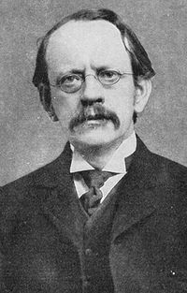
Atoms contain electrons
The first indication that atoms were destructible came at the end of the 19th century when the British scientist J. J. Thomson discovered that different metals produce a stream of negatively charged particles when a high voltage is applied across two electrodes.
As these particles, which we now know as electrons, were the same regardless of the metal, he suggested that they are part of the make-up of all atoms.
As it was known that the atom had no net charge, Thomson pictured the atom as a ‘plum pudding’, with the negatively charged electrons scattered in a positively charged sponge-like substance.

Slide 8
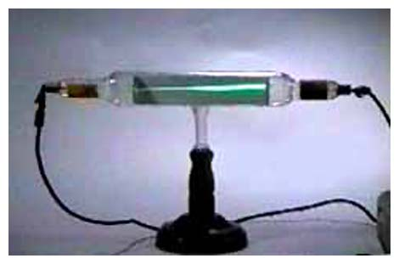
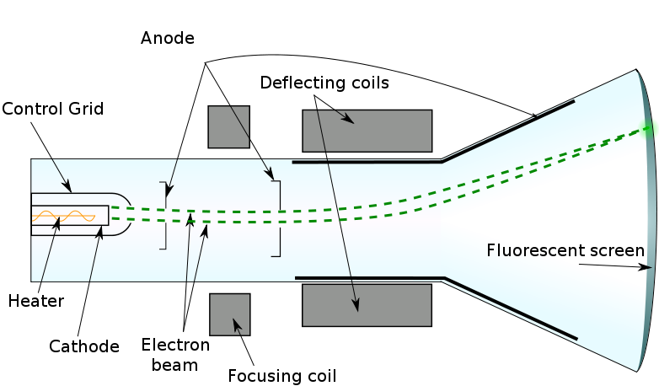
J.J. Thomson’s Cathode Ray Tube (CRT)

Slide 9
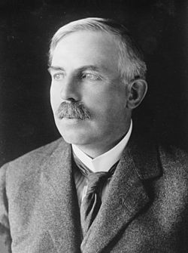
Rutherford’s model of the atom
Ernest Rutherford (1871–1937) and his research team working at Manchester University in England, tested Thomson’s model by ring alpha particles at a piece of gold foil.
We now know that alpha particles are helium nuclei, composed of two protons and two neutrons, with a positive charge.
They are emitted by nuclei with too many protons to be stable.
If Thomson’s model was correct, the alpha particles should either pass straight through or get stuck in the positive ‘sponge’.
Most of the alpha particles did indeed pass straight through, but a very small number were repelled and bounced back.
The large number of undeflected particles led to the conclusion that the atom is mainly empty space.
Large deflections occur when the positively charged alpha particles collide with and are repelled by a dense, positively charged centre called the nucleus.
The fact that only a small number of alpha particles bounce back suggests that the nucleus is very small.

Slide 10
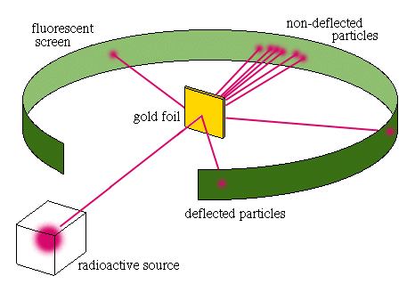
Gold Foil
Experiment

Slide 11
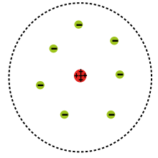
Rutherford’s Model

Slide 12
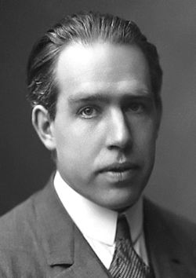
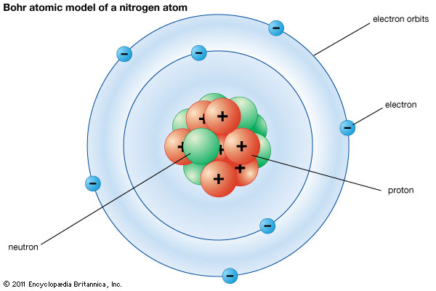
Bohr’s Atomic Model

Slide 13
Sub-atomic Particles
Particle | Where in Atom | Relative Mass | Relative Charge
Proton | Nucleus | 1 | +1
Neutron | Nucleus | 1 | 0
Electron | Orbiting the nucleus | 1/1836 | -1

Slide 14


Symbols with superscripts & subscripts
$${}_{Z}^{A}{X^{e+}}$$
$${}_{11}^{23}{{Na}^{+}}$$
A: Mass number (nucleon number) – sum of proton number and neutron number
Z: Atomic number – proton number
e+: Ionic charge - charge on the cation/anion due to gain or loss of electron(s) [gain electron(s) to have negative charge and loss of electron(s) to have positive charge.]

Slide 15
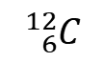

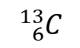

Isotopes
Atom | Protons | Neutrons | Electrons | Relative Mass
 | 6 | 6 | 6 | 12
 | 6 | 7 | 6 | 13
 | 92 | 143 | 92 | 235
 | 92 | 146 | 92 | 238
$${}_{6}^{12}C$$
$${}_{6}^{13}C$$
$${}_{92}^{235}U$$
$${}_{92}^{238}U$$
Isotopes: Atoms that have same proton number but different neutron number.
Abundance: Mole percentage of one isotope in its whole element in nature.

Slide 16
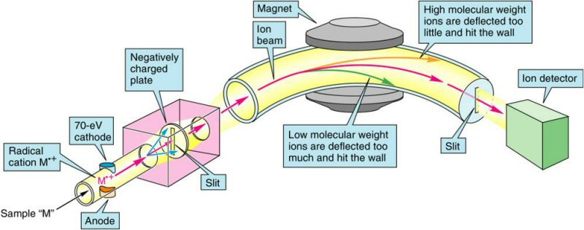
Mass spectrometry (MS) is an analytical technique that measures the mass-to-charge ratio of charged particles.
A mass spectrometer is the instrument which separates particles according to their masses and records the relative proportions of these.

Slide 17
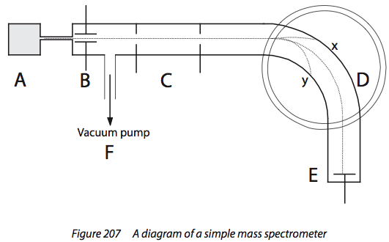
A: Convert substance in vapor phase by heating
B: Turn atom/molecules into positive ions by electron bombardment
C: Accelerate positive ions by electrical field
D: Deflect ions by magnetic field: lighter the particle / bigger the charge the greater the deflection (deflection depends on m/z ratio)
E: Detector record ions of a particular mass: greater the # of particles the greater the signal
F: High vacuum maintained by a pump preventing sample particles colliding w/ other particle

Slide 18

Relative atomic mass (A_{r})
Practice:
Calculate the A_{r} for chlorine.
Relative atomic mass, A_{r}, is the weighted average of all isotopes of an element relative to one-twelfth of an atom of carbon-12.

Slide 19
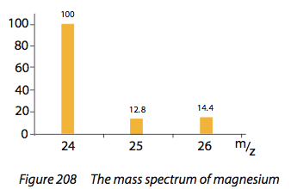
Relative atomic mass of an element
Determine the natural abundances of the isotopes of an element and hence allow calculation of its atomic mass.
Practice:
Relative Abundance
Percentage abundances?
Atomic mass?

Slide 20
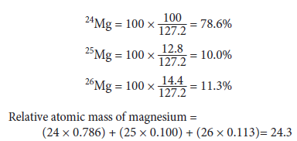
Solution:

Slide 21
Ions
To make atoms neutral, the number of electrons should equal to atomic number
But during chemical reactions, electrons could transfer from one to another to make both atoms become no longer neutral.
Atoms with charge (by gaining or losing electron(s)) are called ions

Slide 22
Exercises about the composition of elements
Element Symbol | Number of particles |  |  | Mass Number
 | Proton | Neutron | Electron
²⁸Si
⁵²Cr³⁺
_Br ⁻ |  |  |  | 79
_Ag |  | 61 | 47
¹³³Ba²⁺
_Rf |  |  |  | 261
14
14
14
28
24
28
21
52
79
35
44
36
108
47
108
56
77
54
133
261
104
157
104

Slide 23
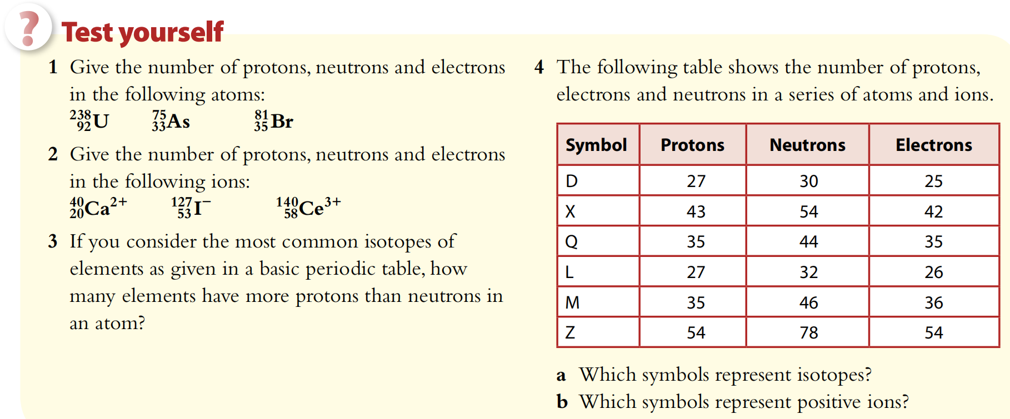

Slide 24
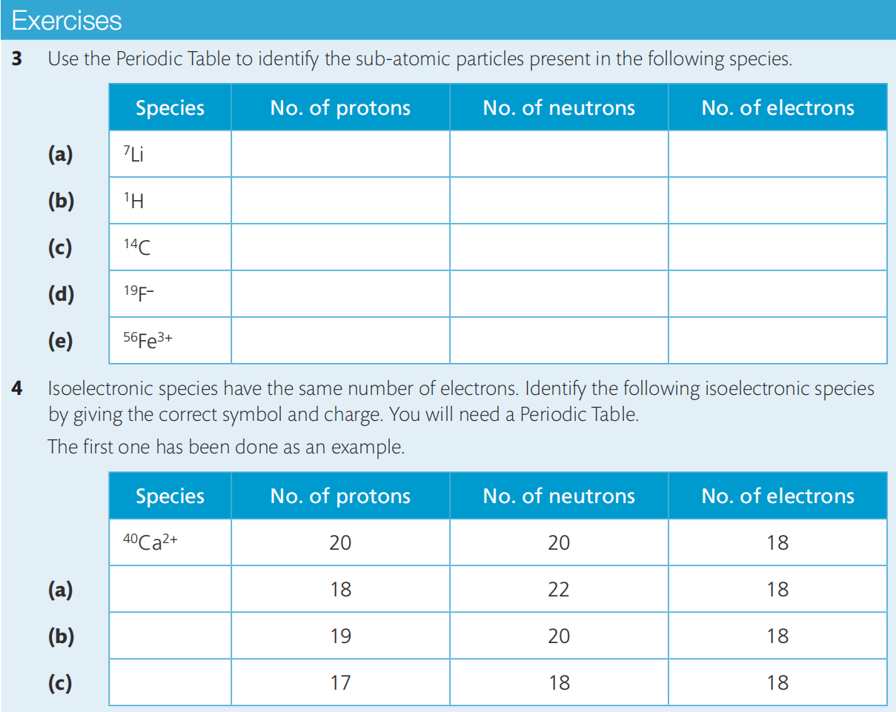

Slide 25
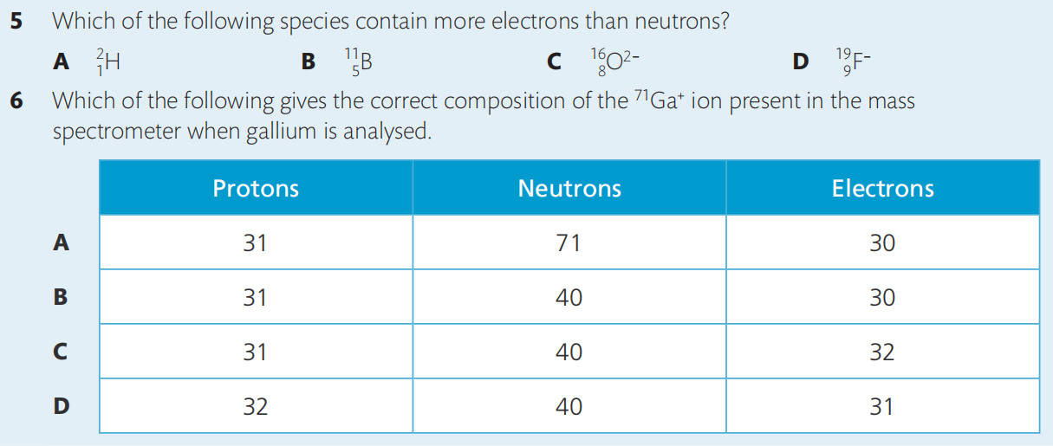

Slide 26
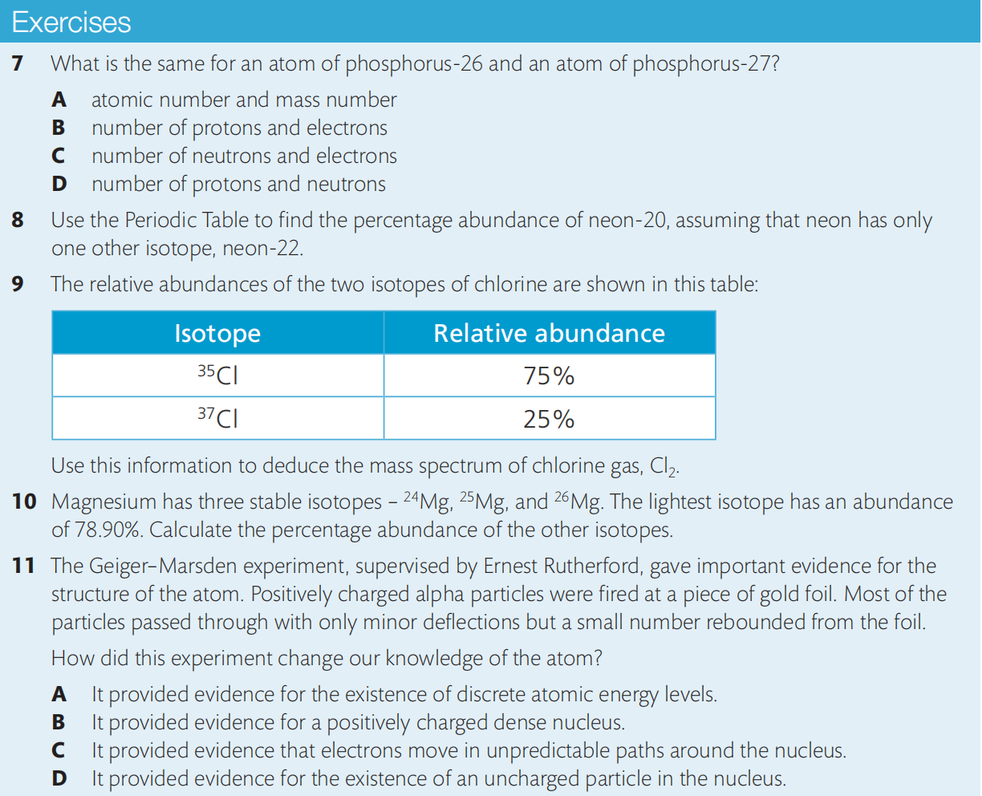

Slide 27
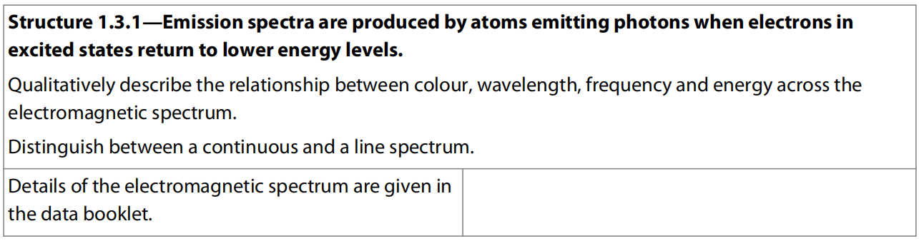
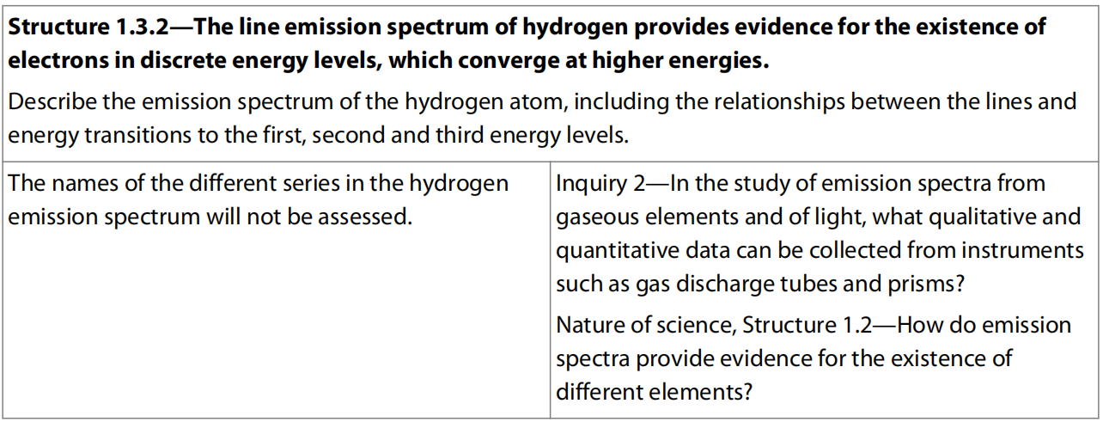
2.2 Electron Configuration

Slide 28
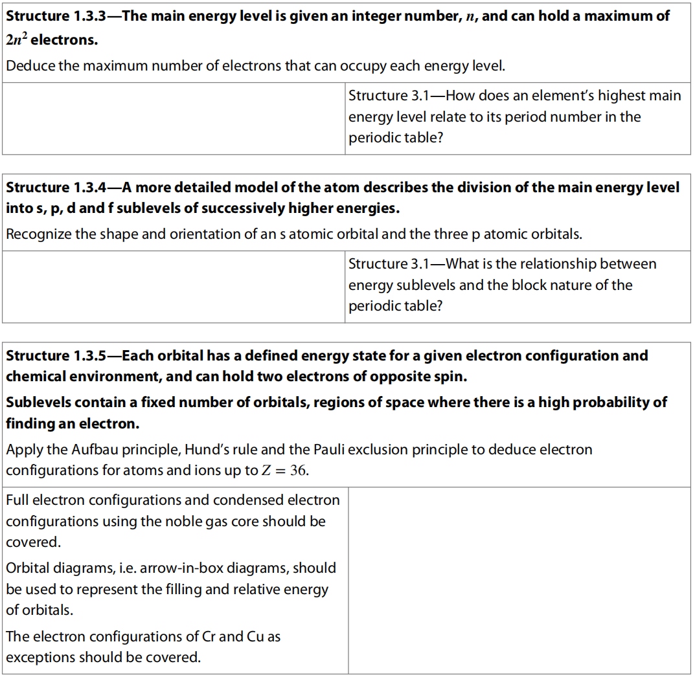

Slide 29
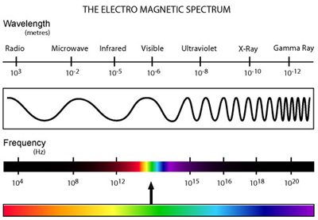
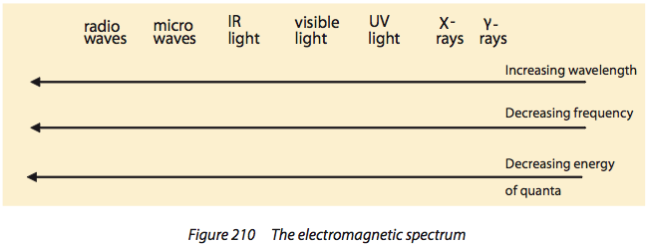

Slide 30
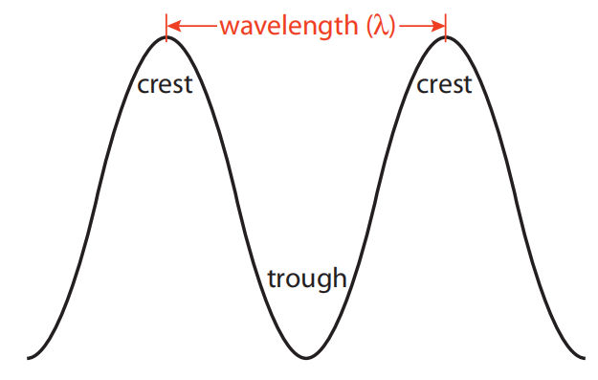
The distance between two successive crests (or troughs) is called the wavelength (λ).
The frequency (ν) of the wave is the number of waves which pass a point in one second.
The wavelength and frequency are related by the equation c = ν λ
where c is the speed of light.
The energy of the photon of light relates to the frequency of the radiation by the Planck equation:
E_{photon} = h ν
This equation and the value of h (the Planck constant) are given in sections 1 and 2 of mthe IB data booklet.

Slide 31
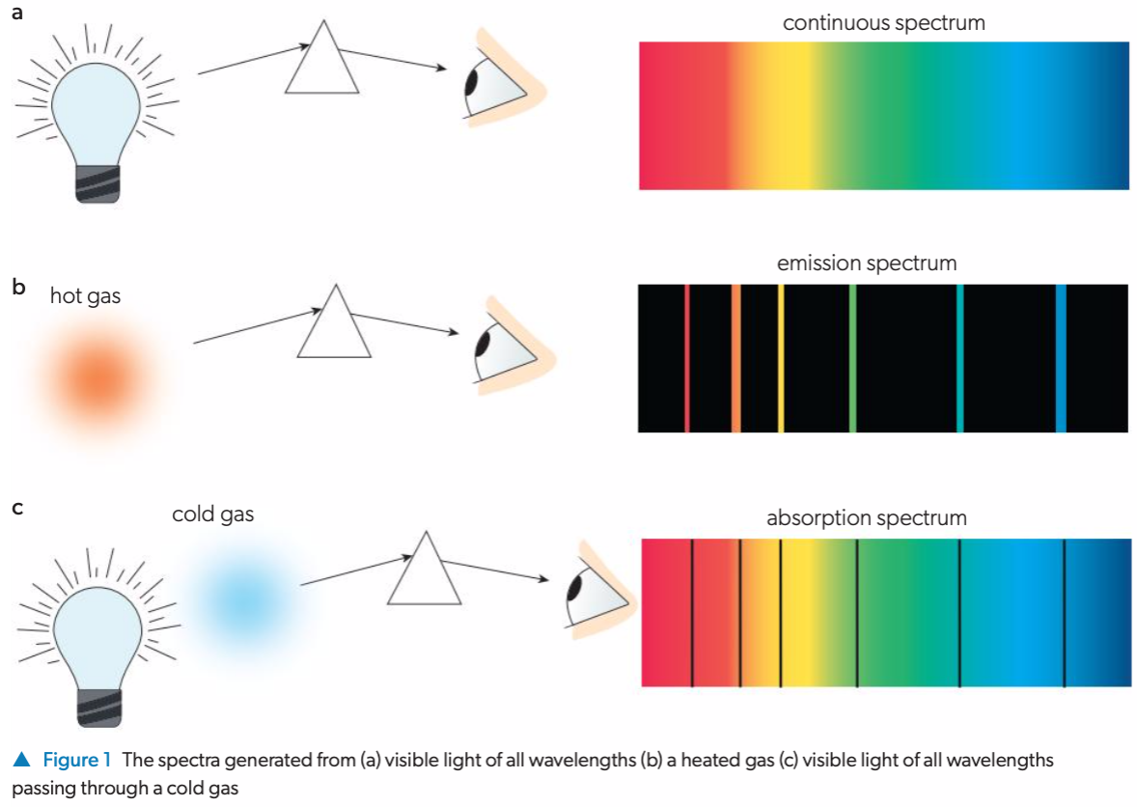

Slide 32
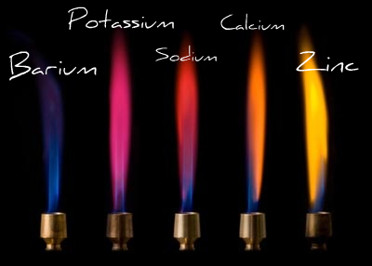

Flame test
When an element is excited it will often emit light of a characteristic color.

Slide 33
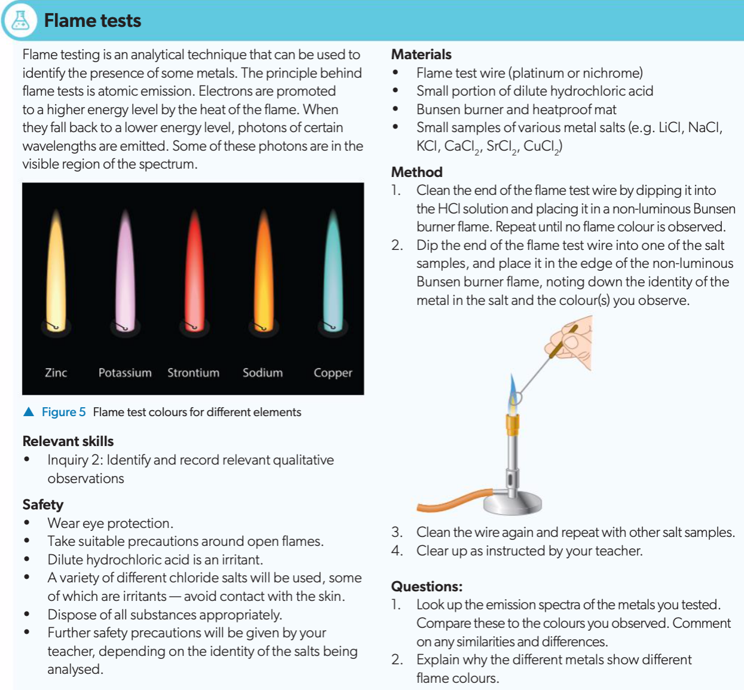

Slide 34
Atomic Emission Spectra
The study of the emission of light by atoms and ions is the most effective technique for deducing the electronic structure of atoms.
The best evidence for the fact that e⁻ in an atom surround the nucleus in certain allowed energy levels/orbitals comes from the study of the emission spectra of elements.

Slide 35
Atomic Emission Spectra
When an electron absorbs energy, it is excited from lower to higher energy level.
The excited electron drops from higher energy level to lower one and releases energy.
The released energy detected as lines would be the atomic emission spectra.

Slide 36
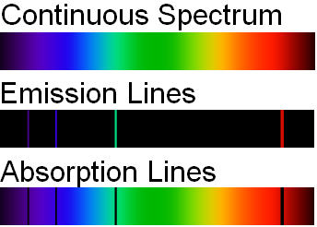
The reverse: Absorption spectrum
H atom: only Lyman series in UV is observed due to only one e⁻ in n=1 level.

Slide 37
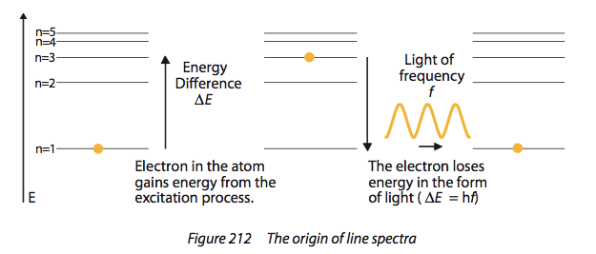
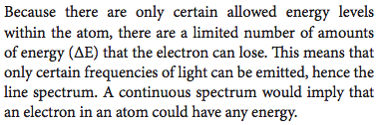

Slide 38
By studying the frequencies of the lines in the emission spectrum of an element, the energies of the various energy levels in its atoms many be found.
It is found that the energy levels are not evenly spaced but that the higher the energy, the smaller the difference in energy between successive energy levels becomes.
This means that the lines in an emission spectrum converge (get closer together) at high energy region.
The limit of this convergence indicate the ionization energy: the energy required to completely remove the electron from the atom (to ionize it)

Slide 39
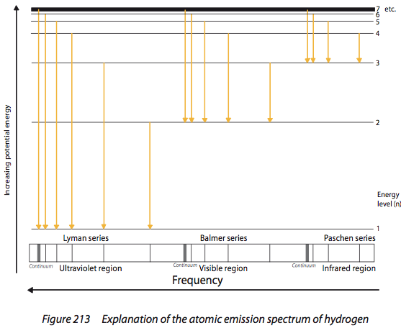
The Atomic Emission Spectrum of Hydrogen
Simplest emission spectrum, having only one electron, no e⁻- e⁻ repulsion causing the principal energy levels to split into different sub-levels.
Line spectrum, indicating only certain allowed e⁻ E levels exist.
Convergence in higher F in spectrum, indicating convergence of higher E levels

Slide 40
For hydrogen emission spectrum:
any lines produced by electrons drop to the 1st energy level (the starting energy level does not matter) would be at UV region (Lyman series);
any lines producted by electron drops to the 2nd energy level would be at visible region (Balmer series);
any lines produced by electron drops to the 3rd energy level would be at IR region (Paschen series).

Slide 41
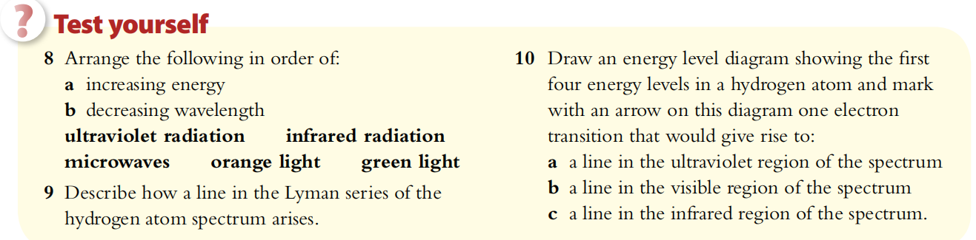
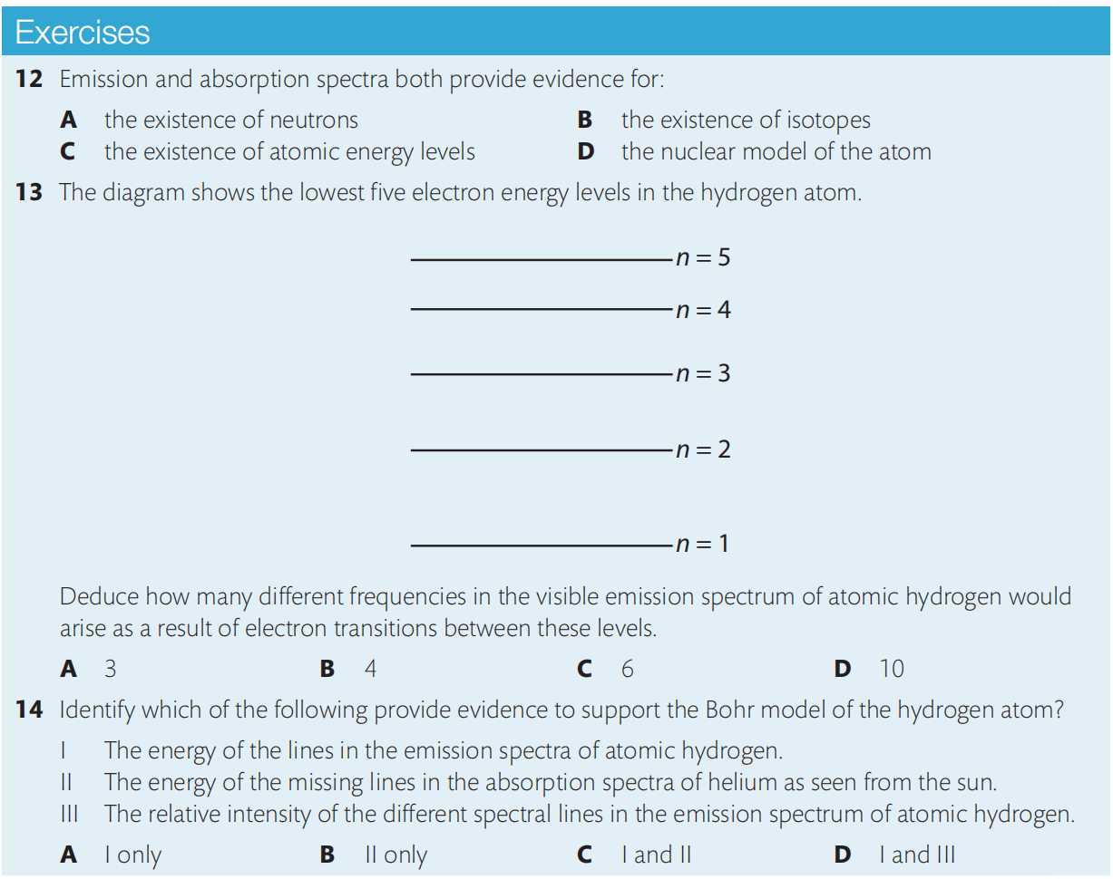

Slide 42
Electronic Structure of the atom
----The number of electron in each orbital
Electrons fill from the lowest energy level (most stable, closest to the nucleus) to higher levels.
There’s a maximum number of e⁻ that each energy level can hold. 2 in 1st level, 8 in 2nd level, and so on (2n² for n^{th} level).
Isotopes have same electronic structure, thus identical chemical properties.
The outermost shell, or valence shell electron number determine the physical and chemical properties of the elements. E.g. most elements with 3 valence e⁻ or less are metals.
Electronic structure of an element is closely related to its position in the periodic table—memory aid for electronic structure.

Slide 43
Shells, sub-shells & orbitals
Electrons are arranged in electrons shells (energy levels).
The shells have sub-shells (sub-levels).
Each shell/sub-shell is made up of electron orbitals which can each hold 2 electrons.
Notes:
The energy levels of the sub-shells are slightly different.

Slide 44
Orbitals
Each sub-level consists of electron orbitals (region of space in which the electron spends most of its time).
Each orbital can hold 2 electrons with opposite spins (one electron spins clockwise and one anticlockwise). (Pauli Exclusion Principle)
Orbitals are regions of space that electrons are most likely to be in.
Notes:
The opposite spins cause less repulsion between the electrons, this is also more energetically favourable.

Slide 45
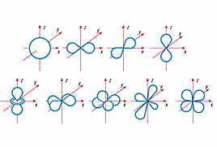
Orbitals
Sub-level | Number of orbitals in sub-level | Shape (no need to learn) | Maximum number of electrons in sub-level
s | 1 |  | 2
p | 3 |  | 6
d | 5 |  | 10
f | 7 | Even more complicated | 14
Notes:
Both atoms in period 1 have an ‘s’ sub-level only, H having one electron and He having 2, no more sub-levels are needed.
Atoms in period 2 have a 1s sub-level, and have their second energy level has two sub-levels, 2s and 3 2p sub-levels.
Period 4 is more complicated still, the 4th energy level comprises one 4s, 5 3d and 3 4p sub-levels.

Slide 46
Orbital Diagram

Slide 47
Aufbau Principle
Electrons enter the lowest energy orbital available.

Slide 48
Hund’s Rule
Electrons prefer to occupy orbitals on their own, and only pair up
when no empty orbitals of the same energy are available.

Slide 49
e.g. silicon 14 e⁻ 1s² 2s² 2p⁶ 3s² 3p²
Notes:
Notice I did not have the computer skills to insert arrows for the electrons here I was lazy and used numbers. BTW 2 means one electron and 4 means an electron of opposite spin, 24 then means a pair of electrons.

Slide 50
e.g. calcium 20 e⁻ 1s² 2s² 2p⁶ 3s² 3p⁶ 4s²

Slide 51
e.g. Ca²⁺ 18 e⁻ 1s² 2s² 2p⁶ 3s² 3p⁶

Slide 52
Ions
The highest energy electrons are lost when an ion is formed.
Once the 4s and 3d orbitals are occupied, 4s moves above 3d in energy, the transition metals then lose there ‘s’ electrons before their ‘d’ electrons.

Slide 53
Ions in period 4
Manganese 2⁺ would be
1s² 2s² 2p⁶ 3s² 3p⁶ 3d⁵

Slide 54
Cu & Cr
Cu and Cr do not have the expected electron structure.
Cr = 1s² 2s² 2p⁶ 3s² 3p⁶ 4s¹ 3d⁵ NOT 1s² 2s² 2p⁶ 3s² 3p⁶ 4s² 3d⁴
Cu = 1s² 2s² 2p⁶ 3s² 3p⁶ 4s¹ 3d¹⁰ NOT 1s² 2s² 2p⁶ 3s² 3p⁶ 4s² 3d⁹
Notes:
This is because a half filled or completely filled d sub-level is energetically very favourable. Atoms, like chemists are lazy, pleasure seekers and always do the least they can for the maximum benefit.

Slide 55
Electronic configuration and the Periodic Table
We are now in a position to understand the structure of the Periodic Table:
elements whose valence electrons occupy an s sub-level make up the s block;
elements with valence electrons in p orbitals make up the p block;
the d block and the f block are similarly made up of elements with outer electrons in d and f orbitals.

Slide 57
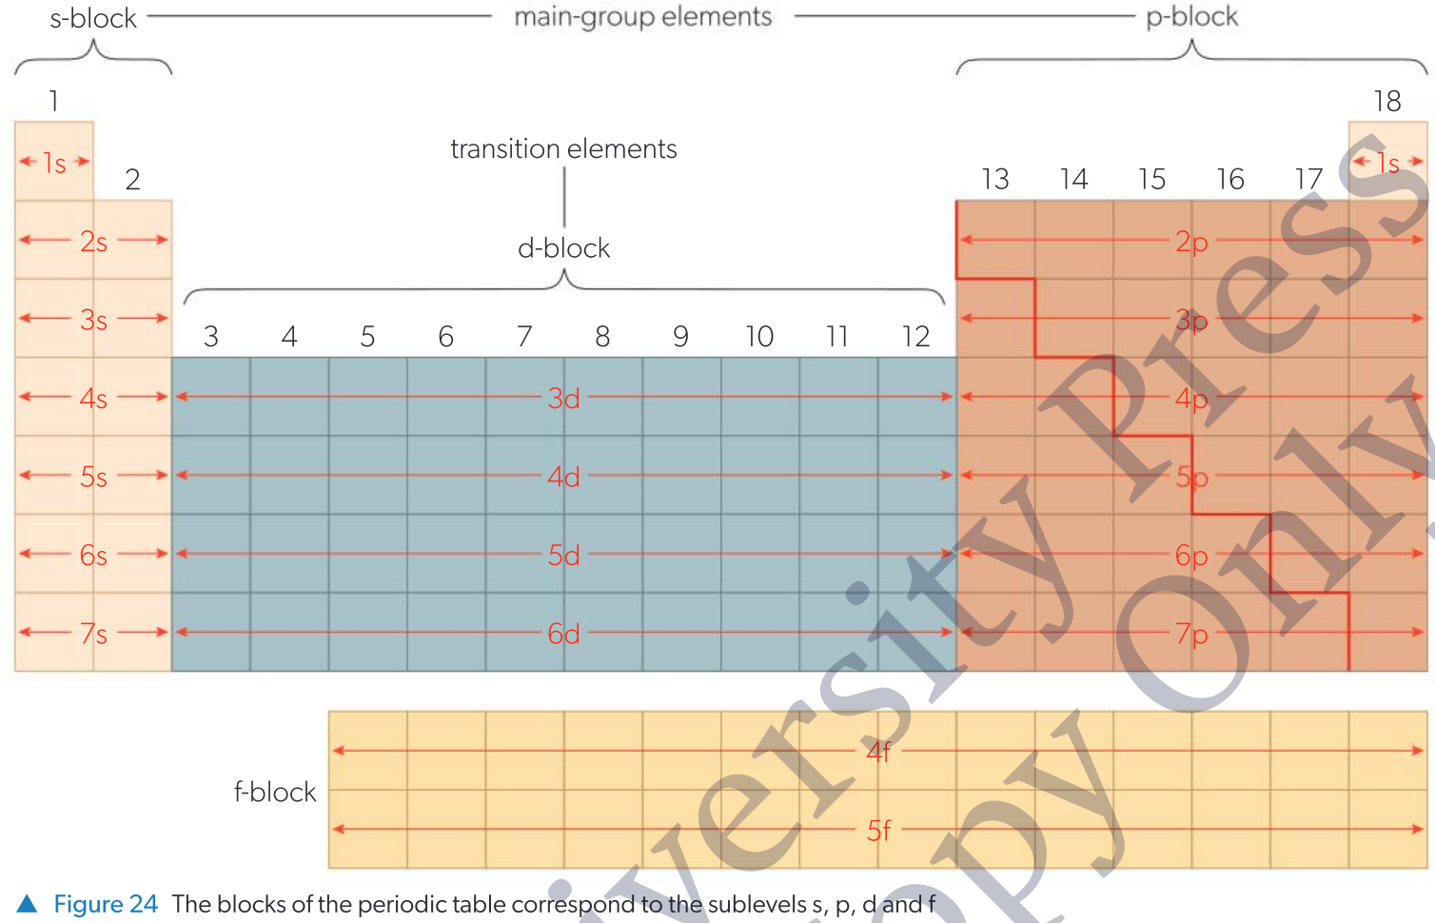

Slide 58
Electronic configuration and the Periodic Table
The position of an element in the Periodic Table is based on the occupied sub-level of highest energy in the ground-state atom. Conversely, the electron configuration of an element can be deduced directly from its position in the Periodic Table.
Here are some examples.
Caesium is in Group 1 and Period 6 and has the electronic configuration: [Xe]6s¹.
Iodine is in Group 17 and in Period 5 and has the configuration: [Kr]5s²4d¹⁰5p⁵.
Placing the 4d sub-level before the 5s gives [Kr]4d¹⁰5s²5p⁵.

Slide 59
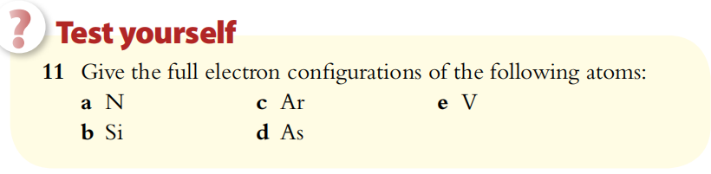
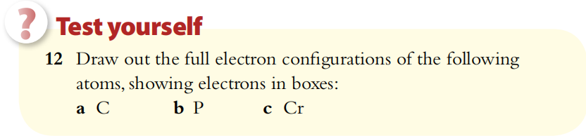
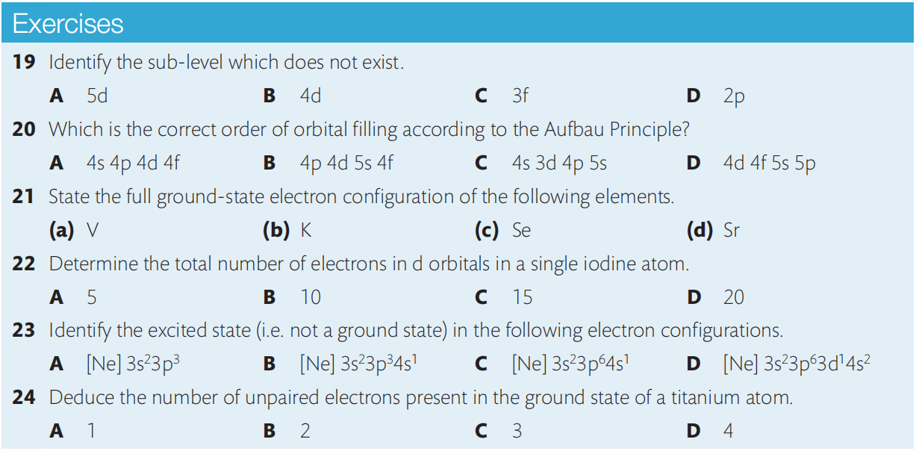
orbital diagrams

Slide 60
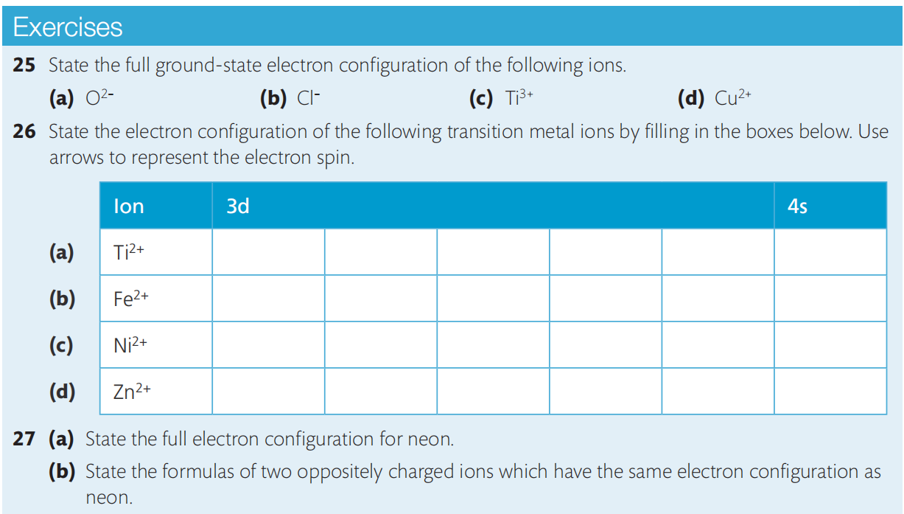
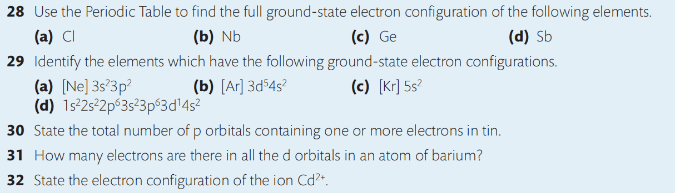

Slide 61
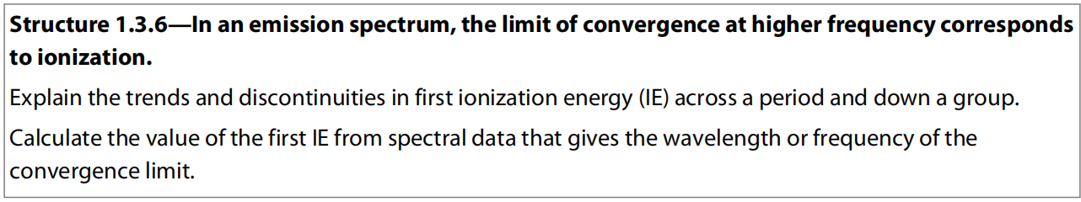
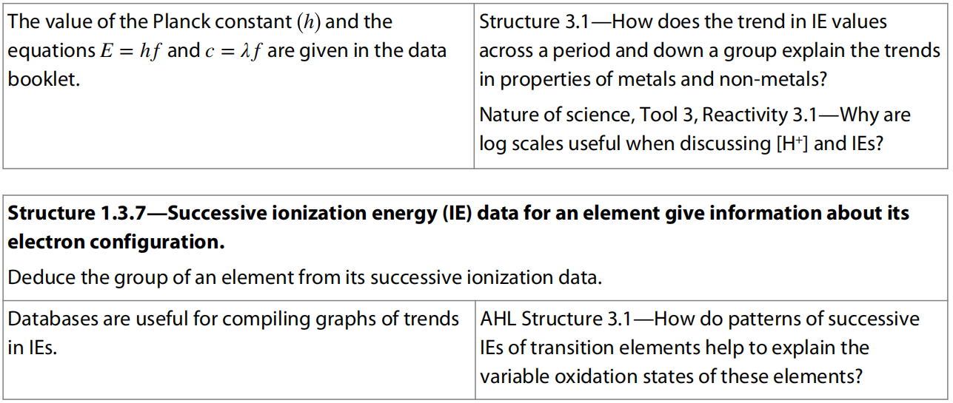
2.3 Ionization Energy of atoms (Higher Level)

Slide 62
Ionisation Energy
Evidence for how the electrons are arranged in atoms comes from ionisation energies.
1st ionisation energy = energy required to remove one electron from each atom in 1 mole of gaseous atoms producing one mole of 1+ gaseous ions.
Note that 2nd ionisation energy is the energy required to remove the second electron (not both electrons).
e.g. 1st IE of Na: Na(g) → Na⁺(g) + e–
2nd IE of Na: Na⁺(g) → Na²⁺(g) + e⁻

Slide 63
Ionisation Energy
Notes:
Don’t forget that electrons are negatively charged, an energy level filled with electrons will repel any other energy levels and also screen outer levels from the attraction of the protons in the nucleus.

Slide 64
1st ionisation energy (down group)
Longer distance between nucleus and outer shell electrons (atoms get bigger)
Same effective nuclear charge (more shielding)
Therefore weaker attraction from nucleus to electron in outer shell

Slide 65
1st ionisation energy (down group)
Notes:
A decrease going down a group as each period has an additional filled energy level between the valence shell (outermost energy level) and the nucleus.

Slide 66
1st ionisation energy (across period)
General trend
Increased effective nuclear charge (i.e. more protons)
Shorter distance between nucleus and outer shell electrons (atoms get smaller)
Therefore stronger attraction from nucleus to electron in outer shell

Slide 67
1st ionisation energy (across period)

Slide 68
1st ionisation energy (across period)
Group 2 → 3
Electron lost from Group 3 element is from p orbital, while that lost from Group 2 element is from s orbital.
p orbital is higher energy than s orbital, so easier to lose electron.

Slide 69
1st ionisation energy (across period)
Group 5 → 6
Group 6 element loses electron from orbital with 2 electrons (p⁴ [up down] [up] [up]).
Group 5 element loses electron from orbital with 1 electron (p³ [up] [up] [up]).
Extra electron-electron repulsions make it easier to lose electron from p⁴ than p³.

Slide 70
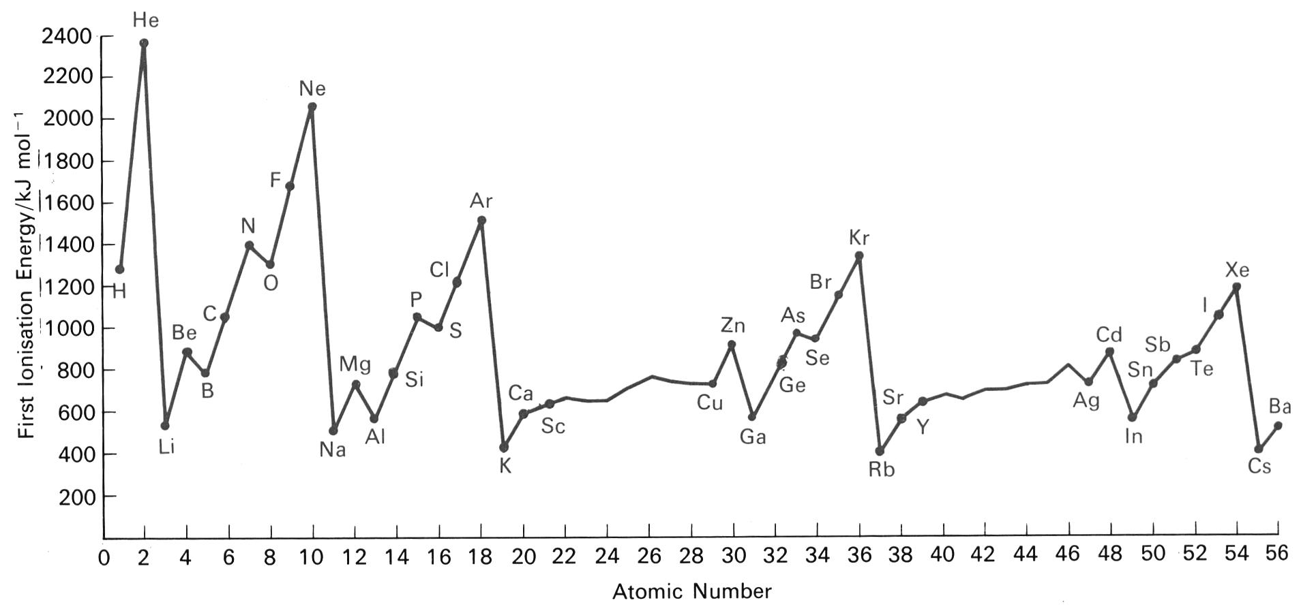
1st ionisation energy

Slide 71
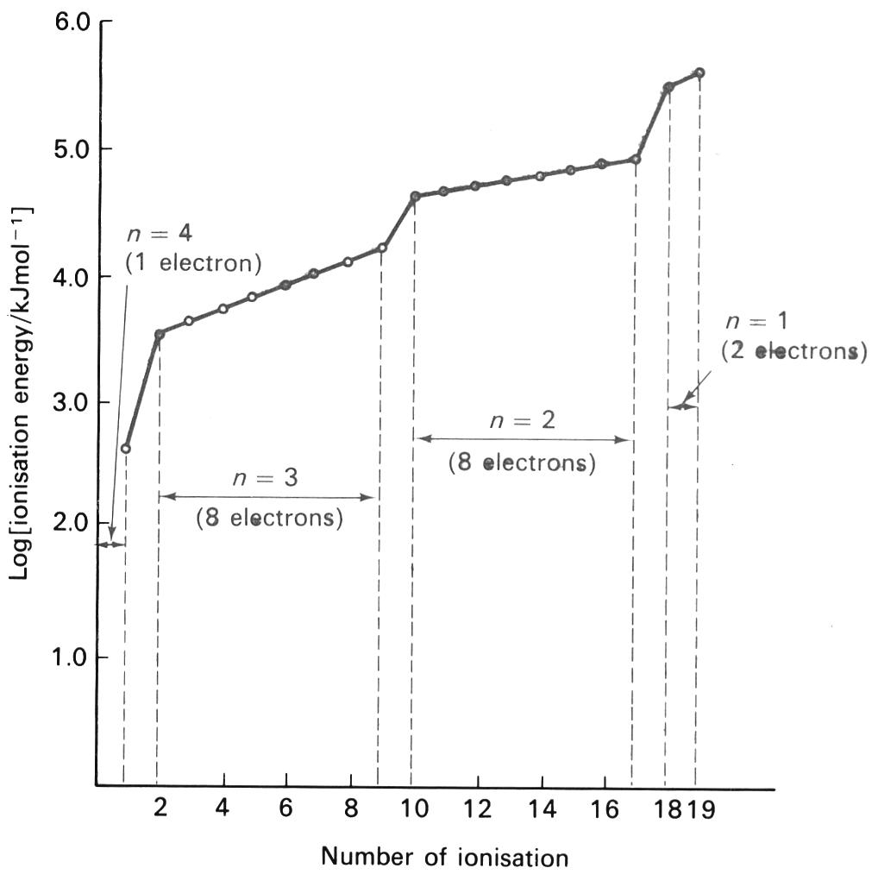
Successive ionisation energies of K
Notes:
Notice the pattern 1,8,8,2. Recall the configuration of potassium 2,8,8,1. This is evidence of the separate energy levels in atoms.

Slide 73
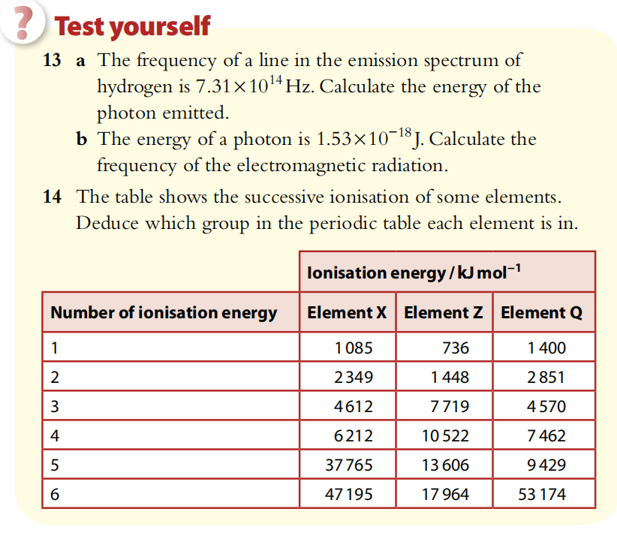

Slide 74
